Slide 1
Adding Binary Numbers

Slide 2
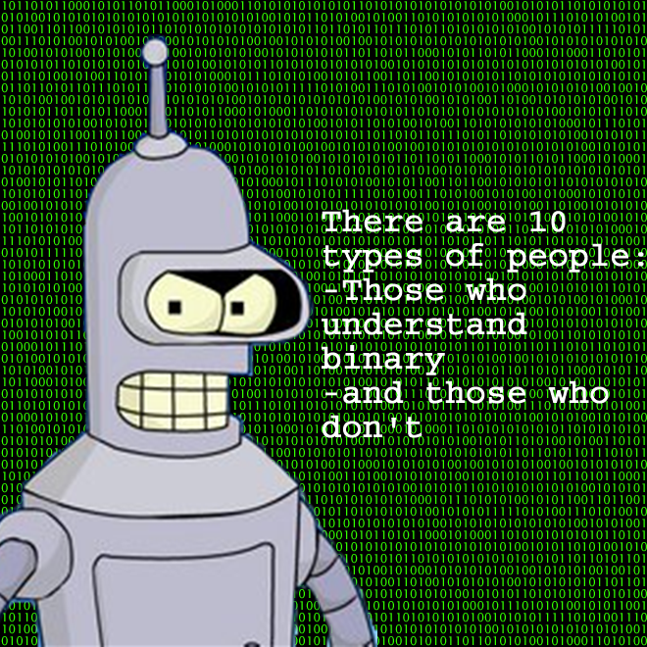
Hook – Deepening thinking
On your post it note –
Explain what this quote means!

Slide 3
Learning Objectives
To be able to add 2 binary numbers (without converting)
To be able to add THREE binary numbers (without converting)

Slide 4
Binary Addition - Challenge
Discuss – How would you add together these two BINARY numbers?
00100010 + 00010100 =

Slide 5
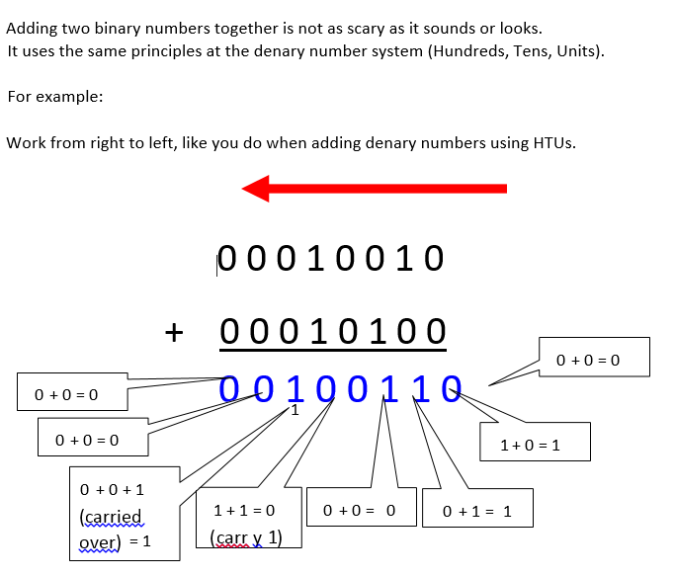

Slide 6
Practice
Questions 1. 00000101 + 00000011 = 00001000 2. 00000111 + 00000111 = 00001110 3. 00001010 + 00001010 = 00010100 4. 00011101 + 00001010 = 00100111 5. 00011111 + 00011111 = 00111110
Questions 1. 00000101 + 00000011 = 2. 00000111 + 00000111 = 3. 00001010 + 00001010 = 4. 00011101 + 00001010 = 5. 00011111 + 00011111 =

Slide 7
So what about adding 3 binary numbers?
01101101 + 00100111 + 00101101 =

